Slide 1
WEATHER, CLOTHES AND SEASONS
Created by Paula López García

Slide 2
In this lesson we will learn how to dress of the
weather.
Let´s start with some vocabulary related to the
clothes.

Slide 3
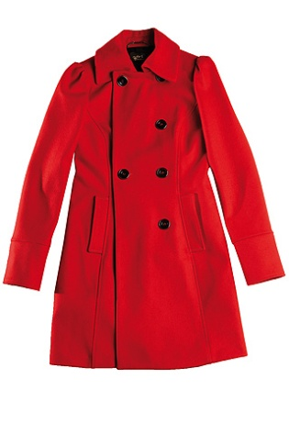
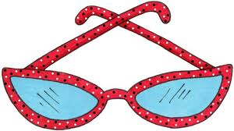
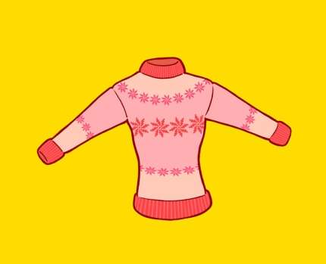
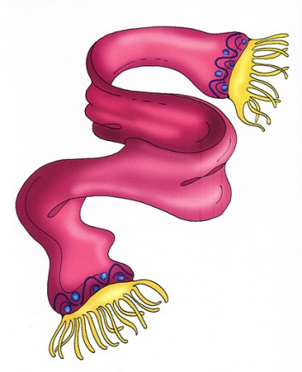
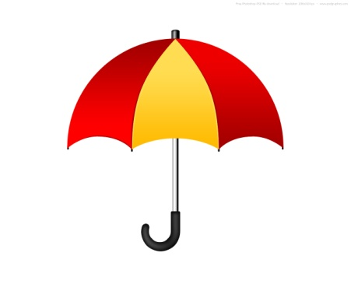
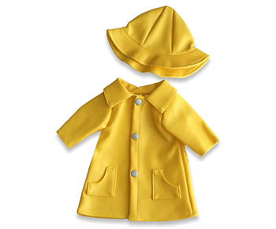
Sunglasses Coat Hat
Sweater Boots Scarf
Umbrella Raincoat

Slide 4
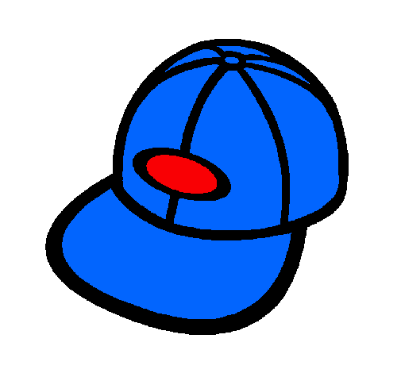
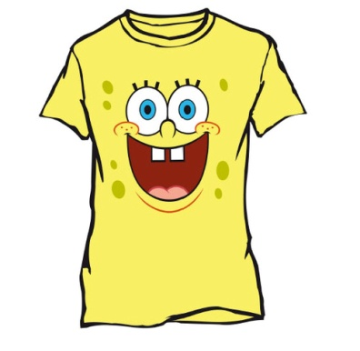
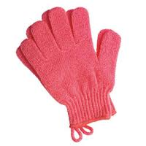
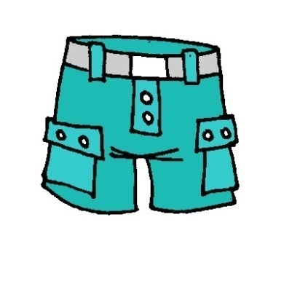
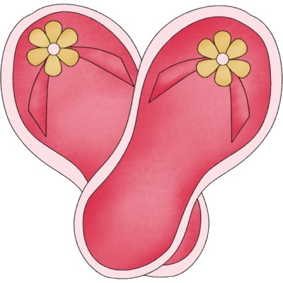
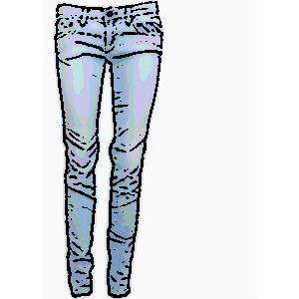
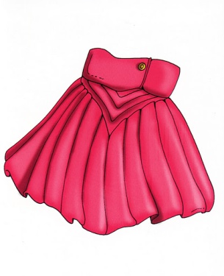
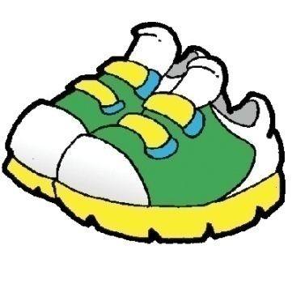
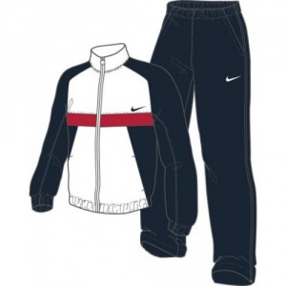
Gloves Cap T- shirt
Jeans Shorts Sandals
Skirt Tracksuit Trainers

Slide 5
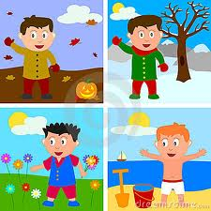
FOUR SEASONS
AUTUMN WINTER
SPRING SUMMER

Slide 6
SEASONS
There are four seasons in a year:
Spring (March, April, May)
Summer (June, July, August)
Autumn (September, October, November)
Winter (December, January, February)

Slide 7
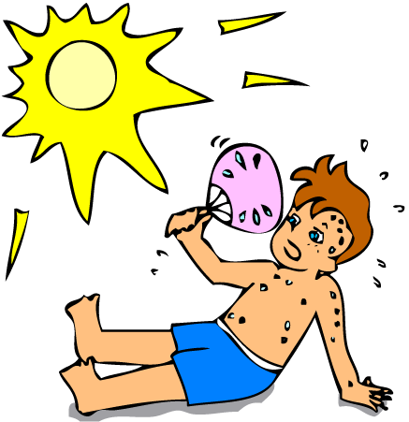
WHAT THE WEATHER LIKE?
HOT SUNNY
It´s hot It´s sunny
It´s hot and sunny. Put on your sunglasses.

Slide 8
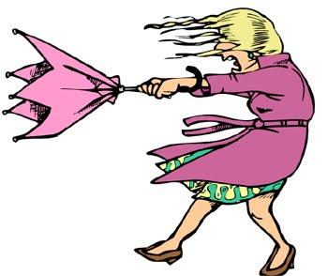
WINDY
It´s windy and rainy. You need your raincoat.

Slide 9
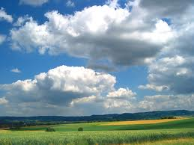
CLOUD CLOUDY
It´s cloud It´s cloudy

Slide 10
RAINY
It´s rainy
You need to bring an umbrella.

Slide 11
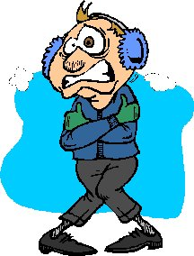
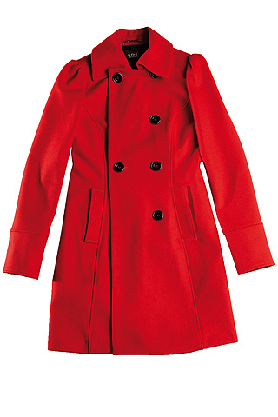
COLD
It´s cold
You need to put on your coat.

Slide 12
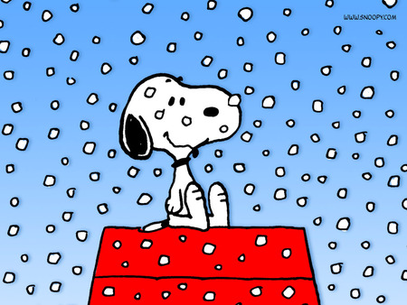
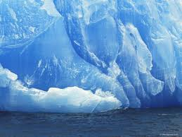
SNOWY FREEZING
It´s freezing cold. You need put on your gloves
and scarf.

Slide 13
WHAT DO YOU WEAR IN……
SPRING | SUMMER | AUTUMN | WINTER
Dress | Shorts | Jacket | Boots
Jeans | Skirts | Sweater | Gloves
Shirts | Sandals | Rain coat | coat
cap | T- shirts

